Slide 1
C++ Basics

Slide 2
OOPS
Object Oriented programming (OOP) is a programming paradigm

Slide 3
Solid Principles
SOLID Principles is a coding standard
S-Single Responsibility Principle
O-Open-Closed Principle:
L-Liskov Substitution Principle
I-Interface Segregation Principle
D-Dependency Inversion Principle

Slide 4
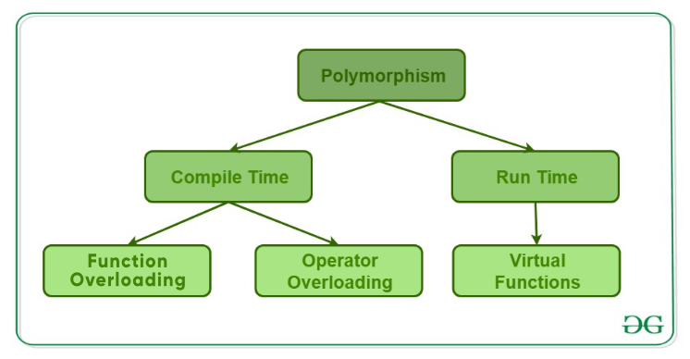
Polymorphism
Polymorphism is considered as one of the important features of Object Oriented Programming.

Slide 5
Inheritance
The capability of a class to derive properties and characteristics from another class is called Inheritance

Slide 6
C++
C++ is a general-purpose programming language
C with Classes". The language has expanded significantly over time, and modern C++ now has object-oriented, generic, and functional features

Slide 7
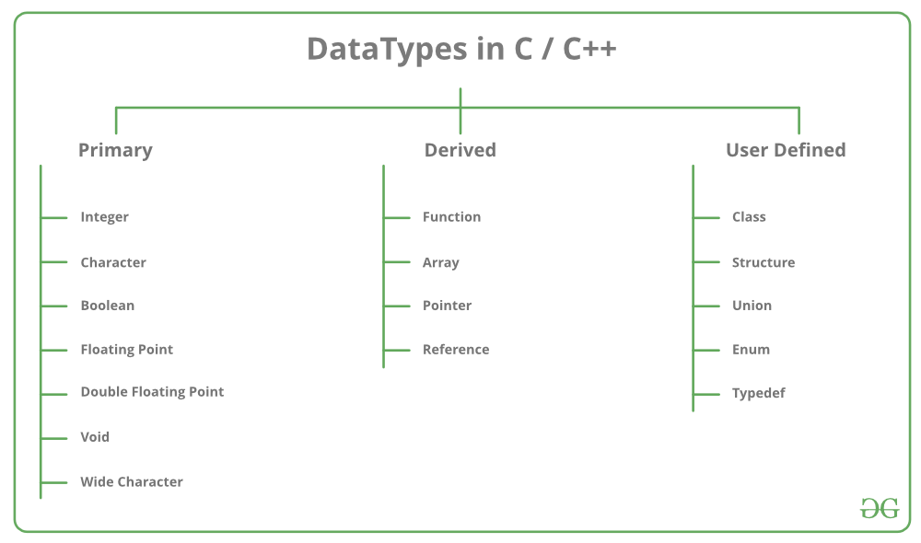
Data types:

Slide 8
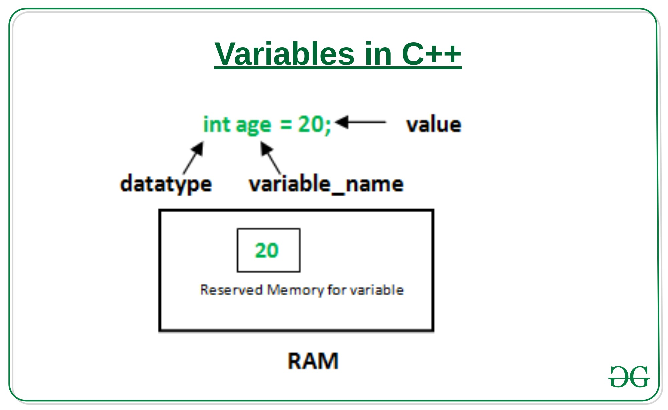
Variables

Slide 9
Basics
Header - #include <iostream>
Using namespace std;
Main function()

Slide 10
Output
#include <iostream>
using namespace std;
int main()
{
char sample[ ] = “_Varthai_";
cout << sample << " - A computer science portal for geeks";
return 0;
}

Slide 11
Input
#include <iostream>
using namespace std;
int main()
{
int age;
cout << "Enter your age:";
cin >> age;
cout << "\nYour age is: " << age;
return 0;
}

Slide 12
Extras
Un-buffered standard error stream (cerr)
buffered standard error stream (clog)
cerr << "An error occured";
clog<< "An error occured";

Slide 13
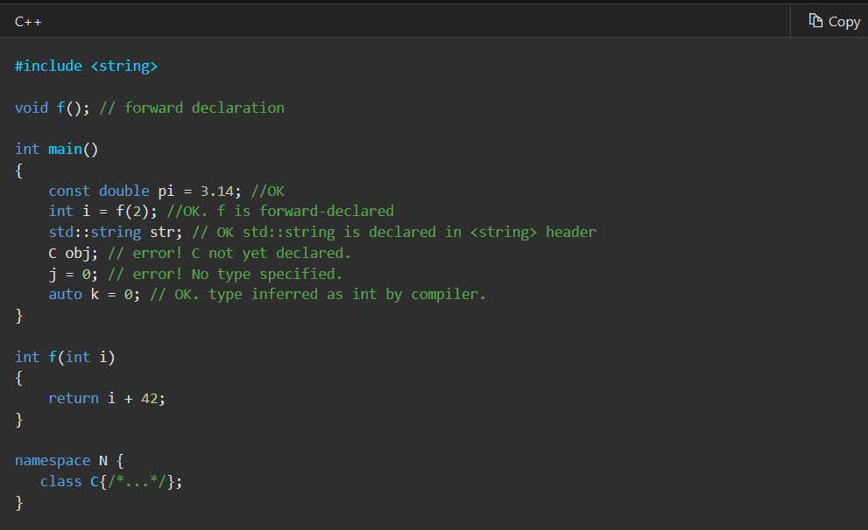
Declaration

Slide 14
Assignments
variable = expression; variable = constant;
total = a + b;//expression
pi=3.14; //constant

Slide 15
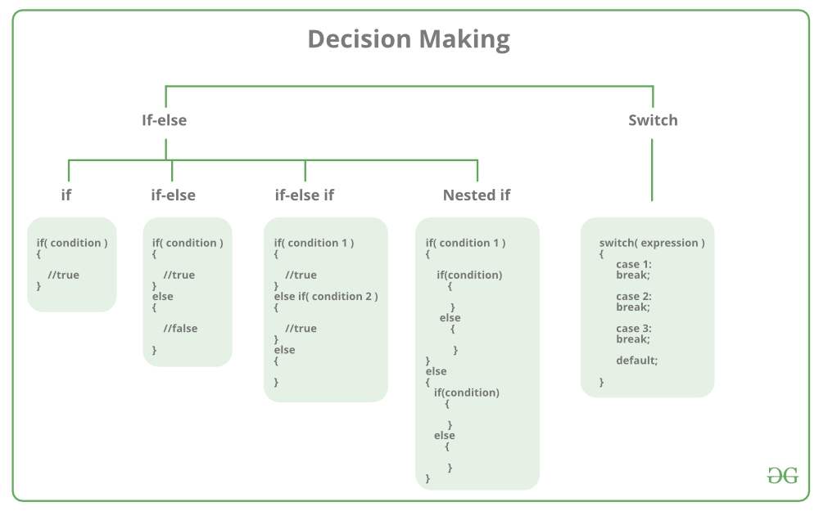
Control Statements

Slide 16
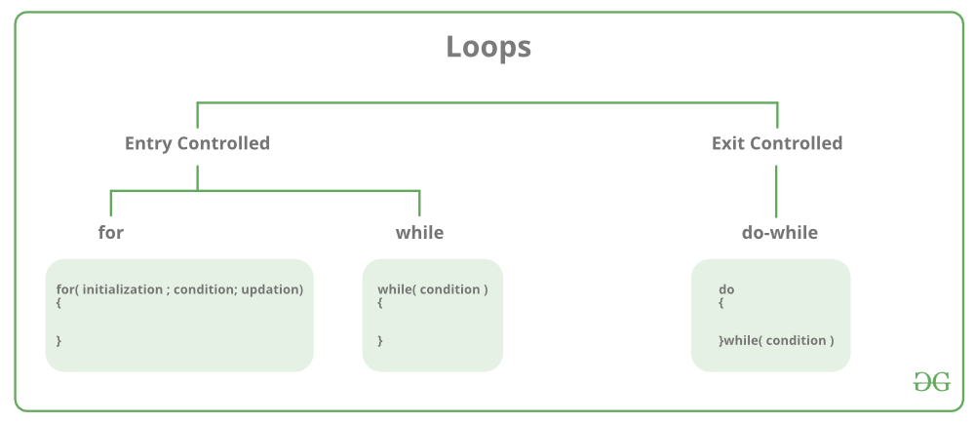
Loop

Slide 17
Function
A function is a group of statements that together perform a task
# Definition
# Calling
# Default Value
Defining a Function
return_type function_name( parameter list )
{
body of the function
}

Slide 18
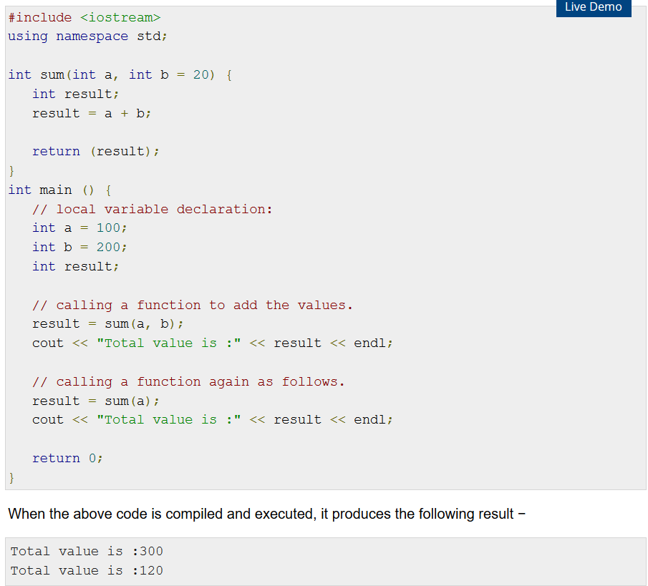

Slide 19
Parameters Return Statement
Call by value
Call by reference
Return <what ?> ;

Slide 20
Thank you

